Slide 1
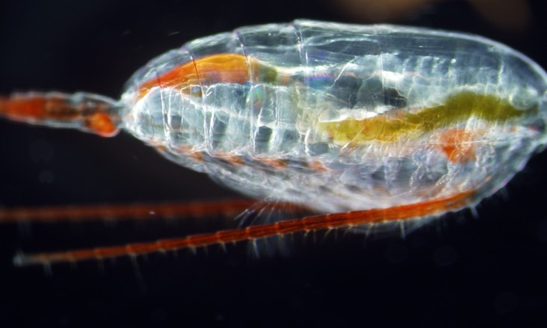
ADAC Annual Meeting Project Briefing:
Mitigating the Damage to Arctic Copepods from Surface Oil Spills: When to Apply Dispersants.
PI: Dr. Christoph Aeppli, caeppli@bigelow.org
Co-PI: Dr. David Fields, dflelds@bigelow.org
Technicians: Maura Niemisto, Phoebe Keys, Erin Beirne
Student Participants: Cameron Carlson/Sam McNeely
Project Champion: CAPT Kirsten R. Trego
Advisory Group: Dr. Robyn Conmy, EPA
Greg Hall USCG Academy Sarah Allan NOAA
1 mm

Slide 2
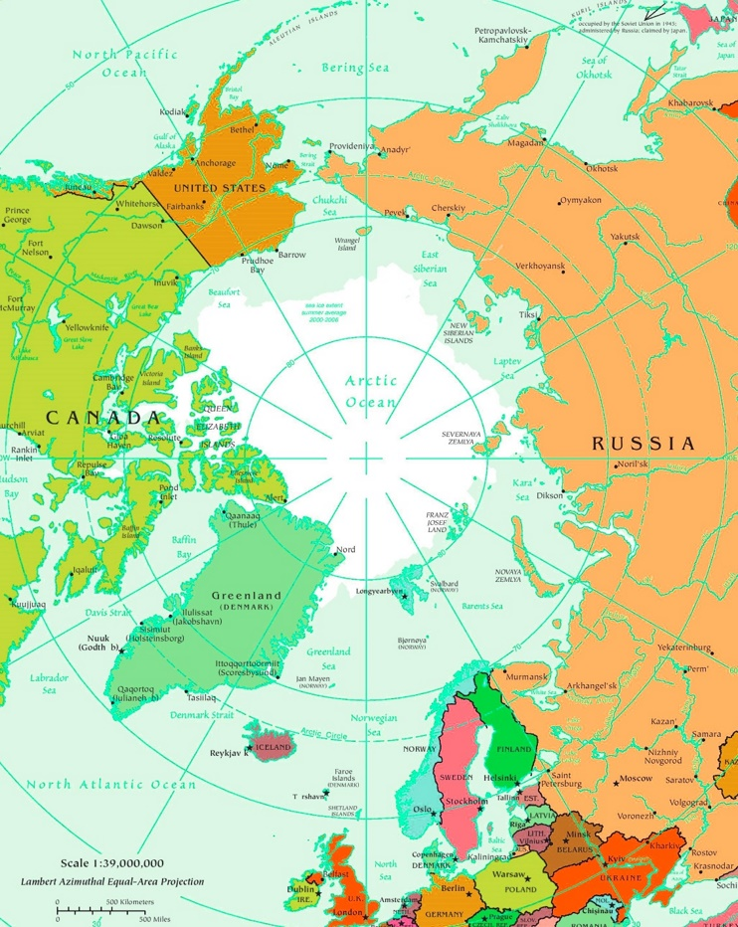
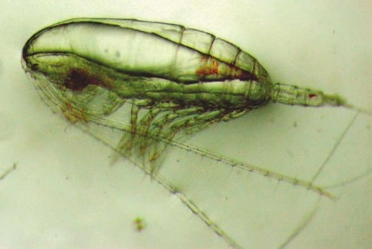
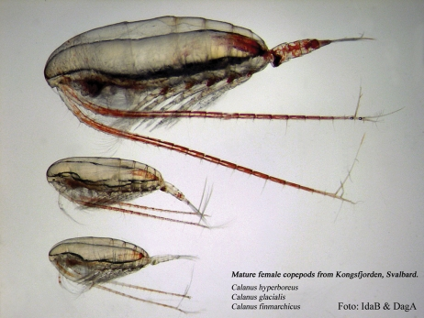
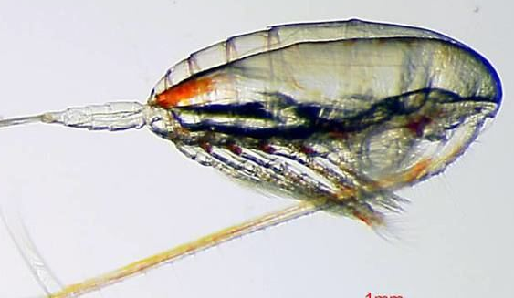
Why Calanus finmarchicus?
Calanus marshallae
Calanus hyperboreus
Calanus glacialis
Calanus
finmarchicus

Slide 3
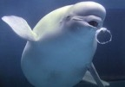
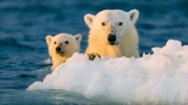


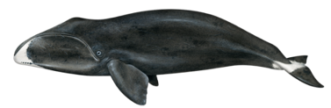




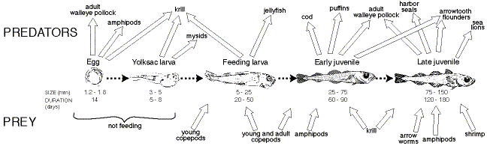

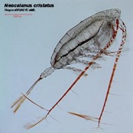
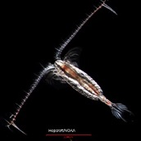
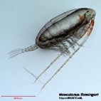
Copepods are the base of the Arctic food web.
ADAC Program Year 6 Annual Meeting 14 May 2020
Polar Bear
Walrus
Beluga Whale
Ringed Seal
Bow Whale
Arctic Cod
Alaskan Salmon
Pollock
Char
Arctic Tern

Slide 4
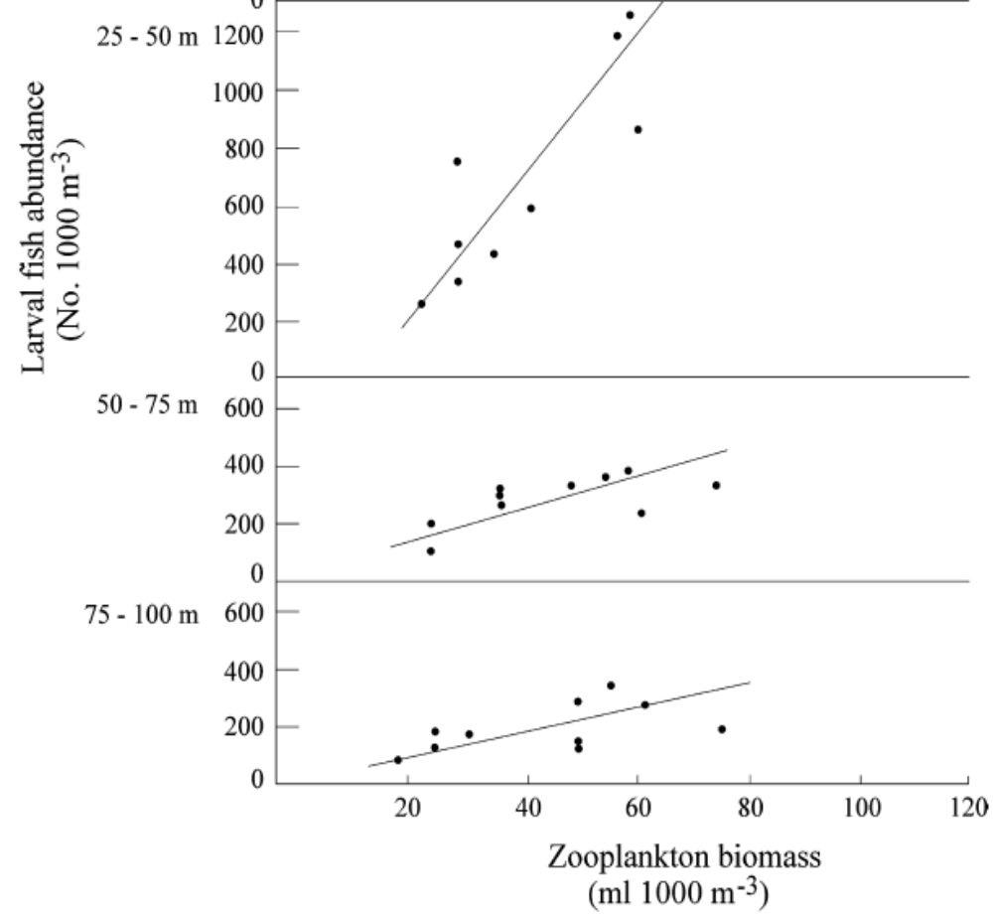
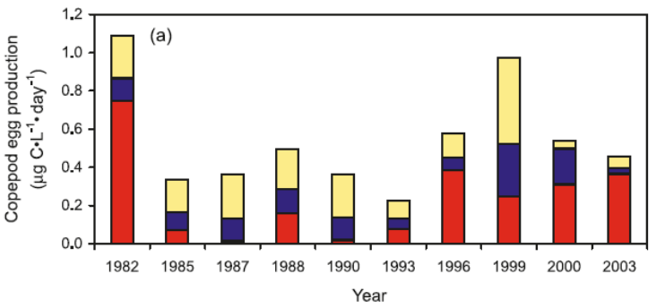
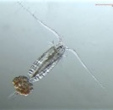

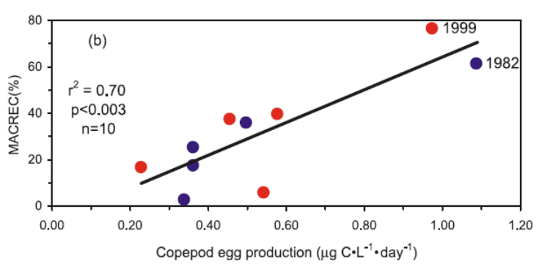



Good Copepod year – Good fish year
ADAC Program Year 6 Annual Meeting 14 May 2020
Laura Sanvicente-Añorve et al, 2006 Hydrobiologia

Slide 5
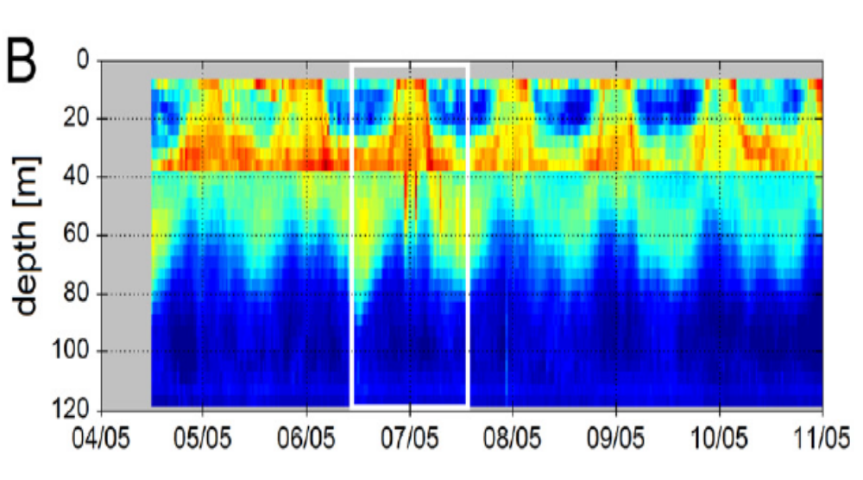
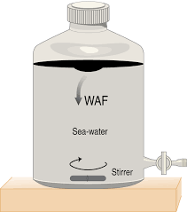



Distribution Temporal/Spatial
ADAC Program Year 6 Annual Meeting 14 May 2020
Previous experiments have placed copepods in jars with oil. No chance for the animals to avoid the spill.

Slide 6
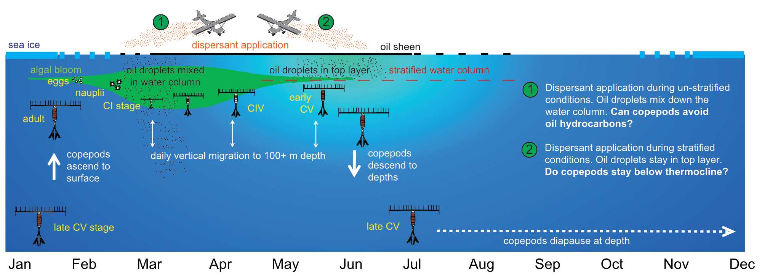
Mitigating the Damage to Arctic Copepods from Surface Oil Spills:
When to Apply Dispersants.
ADAC Program Year 6 Annual Meeting 14 May 2020
Project goal:
To create a set of knowledge products that inform decision-making about when to apply dispersants after an oil spill to minimize damage to the base of the food chain. Specificlly, we focus on zooplankton (copepods).

Slide 7
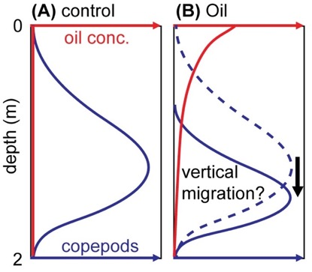
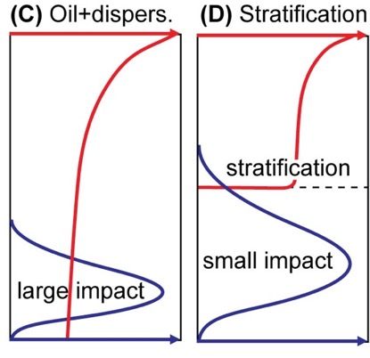
OBJECTIVES
ADAC Program Year 6 Annual Meeting 14 May 2020
In laboratory mesocosm experiments we address the following three objectives:
Objective 1: Determine whether C. finmarchicus copepods actively and effectively avoid oil in mesocosm experiments (Phase I)
Objective 2: Investigate how dispersants influence the exposure of subsurface animals to oil products (Phase II).
Objective 3: Determine how water column stratification the contact between copepods and oil (with and without dispersants) (Phase III)
oil
Oil layer
200 cm
25 cm

Slide 8
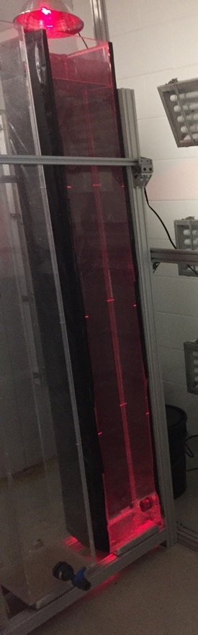
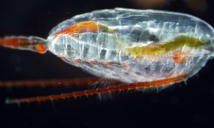
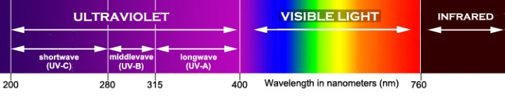
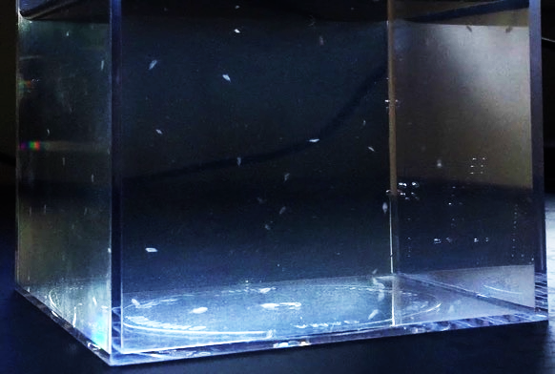
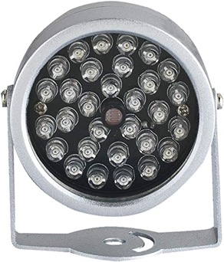
Progress in meeting research objectives
ADAC Program Year 6 Annual Meeting 14 May 2020
Copepod Towers Constructed
Video IR Setup
Calanus copepod
copepod in tower
copepod tower

Slide 9
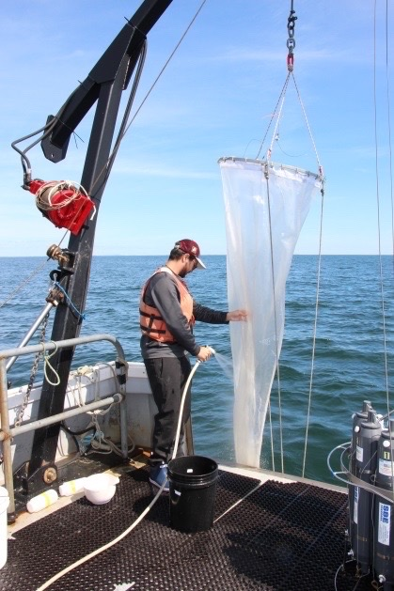
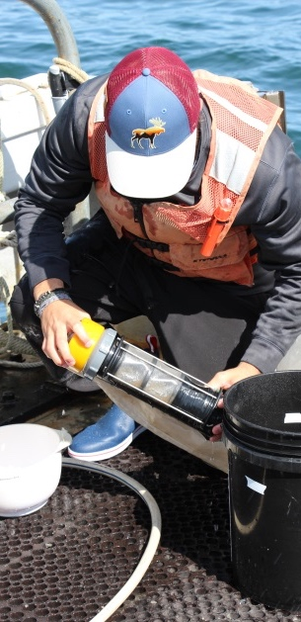
Progress in meeting research objectives
ADAC Program Year 6 Annual Meeting 14 May 2020
Chemical Sampling and Analytical Method Optimized
Copepods Collected and maintained in the Lab
Sample collection and SPME-GC/MS analysis

Slide 10
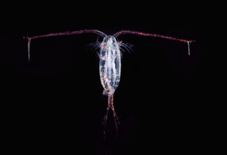



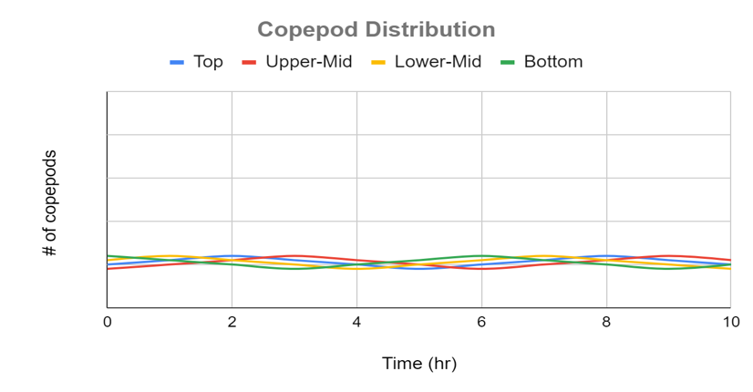
ADAC Program Year 6 Annual Meeting 14 May 2020
OBJECTIVE 1
Determine whether copepods actively and effectively avoid oil in mesocosm experiments (Phase I)
1
2
3
5
4
6
4 cameras – each visualize 10 l
Video recorded at 1 Hz simultaneously from all cameras
Lighting is done using IR lights
Oil concentration measured from 5 sampling ports

Slide 11



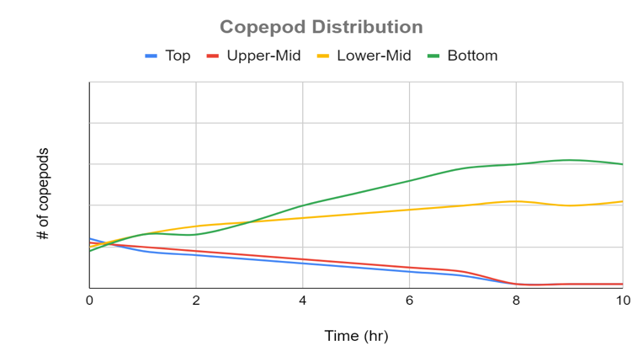
ADAC Program Year 6 Annual Meeting 14 May 2020
OBJECTIVE 1
Determine whether copepods actively and effectively avoid oil in mesocosm experiments (Phase I)
Oil
1
2
3
5
4
6
Copepods are counted in each field of view to determine change in vertical distribution.
thermocline

Slide 12
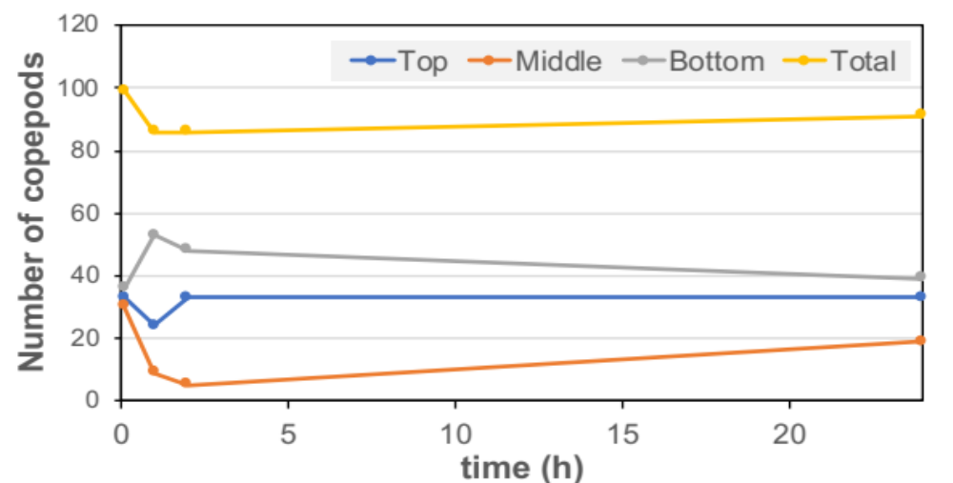
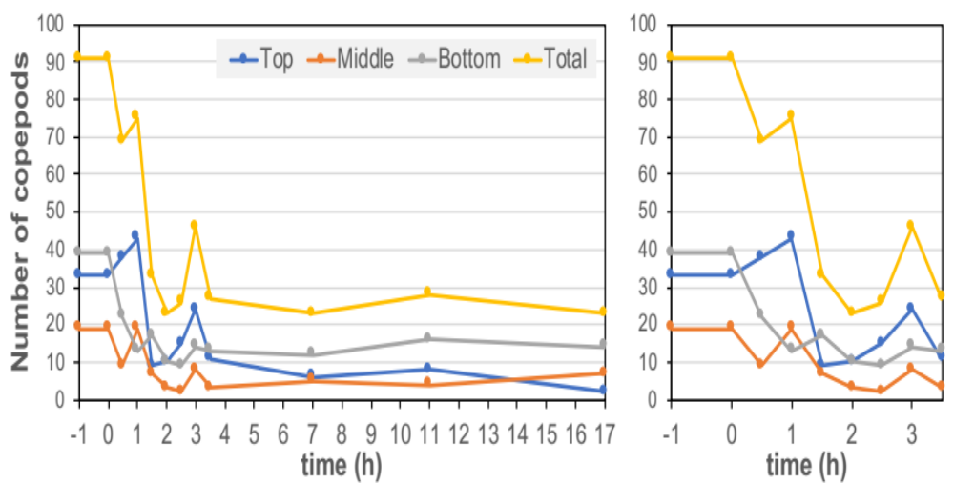
RESULTS
ADAC Program Year 6 Annual Meeting 14 May 2020
CONTROL
NO OIL:
Copepod distribution within the water column remained stable during the 24-hour control run
OIL ADDITION:
Copepods react immediately to oil in all observed depths
Total copepod abundance drops by 72% in the first 4 hour
Results indicate that the copepod behavior is influenced by the presence of low concentrations of oil
+Oil
Next Step: Confirmatory experiments; Synthesis of all data (manuscript)

Slide 13
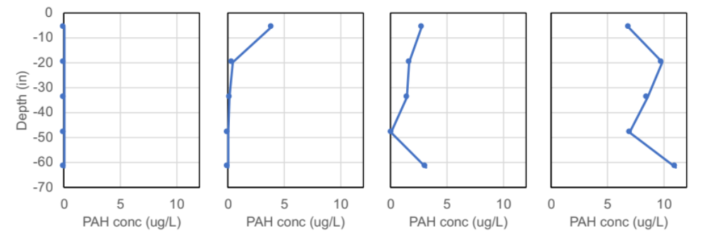
Results Hydrocarbon gradient, no dispersants
ADAC Program Year 6 Annual Meeting 14 May 2020
0h
2h
6h
24h

Slide 14
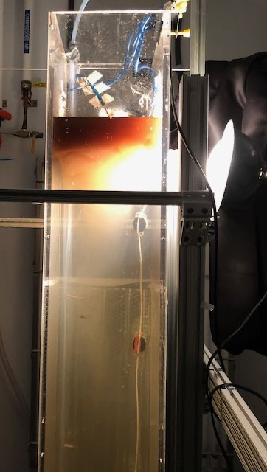
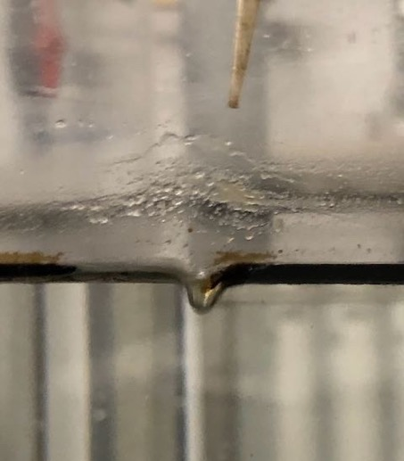
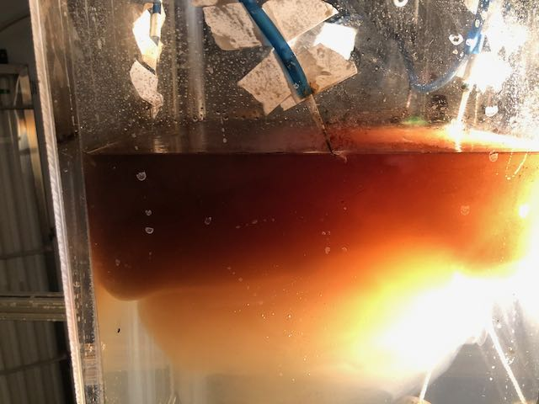
ADAC Program Year 6 Annual Meeting 14 May 2020
OBJECTIVE 2: Determine the influence of dispersant on the veritical
movement of copepods (Phase II)
added airstream as energy to disperse oil
oil/dispersant mixture rapidly disperses, and forms a “cloud” that travels down the column within approx. 6 hours
→ Suitable conditions to produce hydrocarbon gradients with dispersed oil has been identified

Slide 15
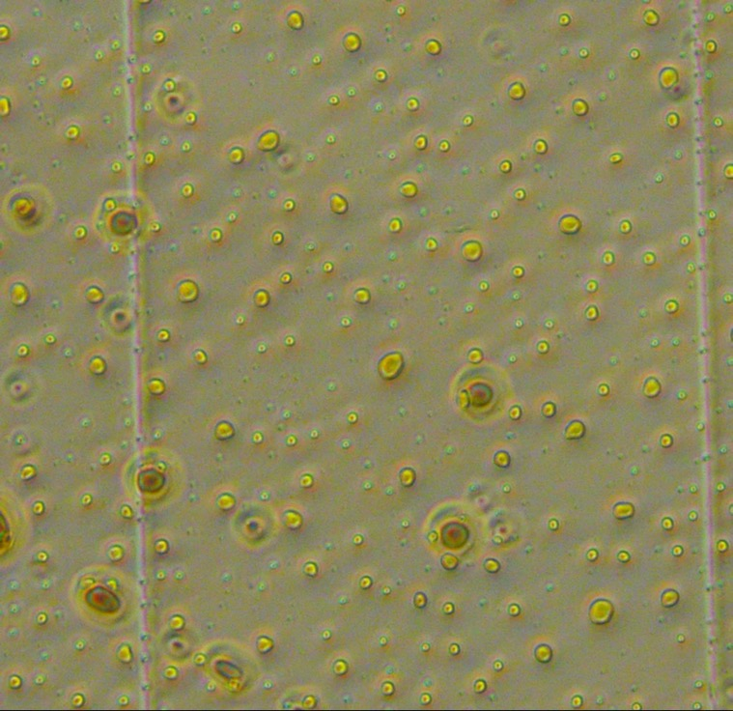

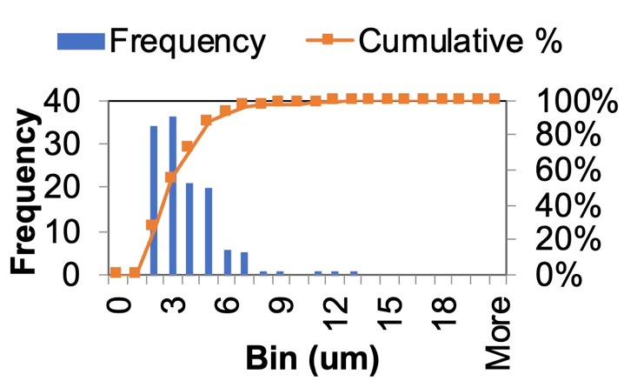
ADAC Program Year 6 Annual Meeting 14 May 2020
Method: Measurement of Droplet Size Distribution
droplet size distribution and oil concentration measured by light (left) and fluorescence (right) microscopy
Next Step: Experiments with life copepods and oil/dispersants

Slide 16
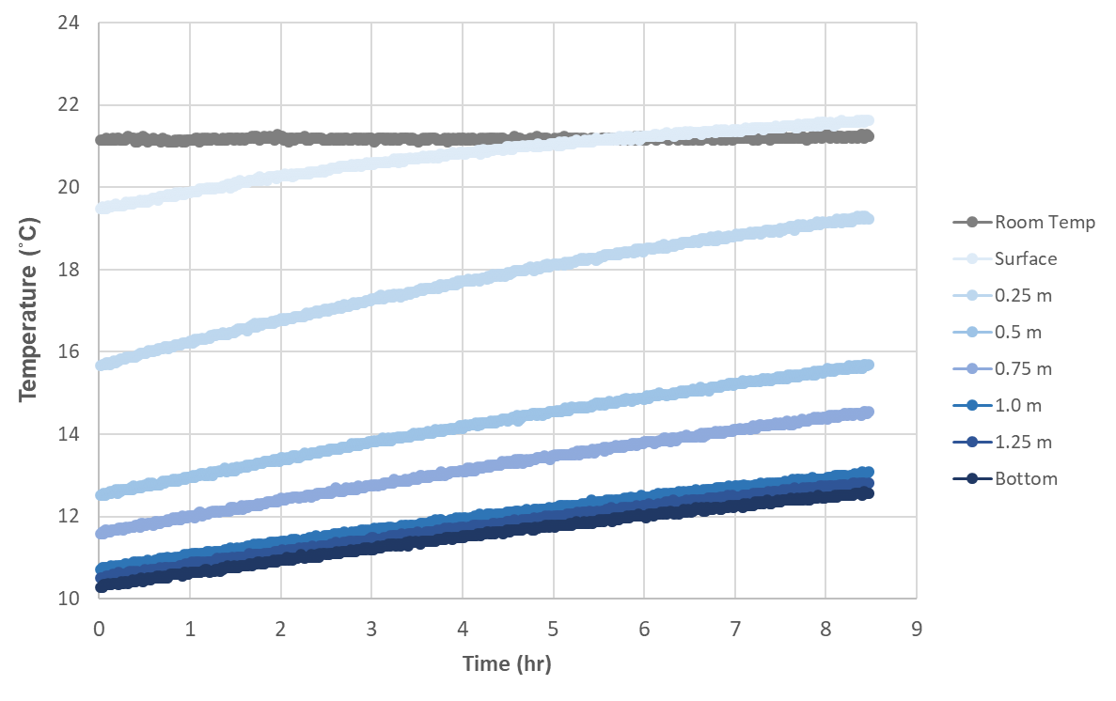
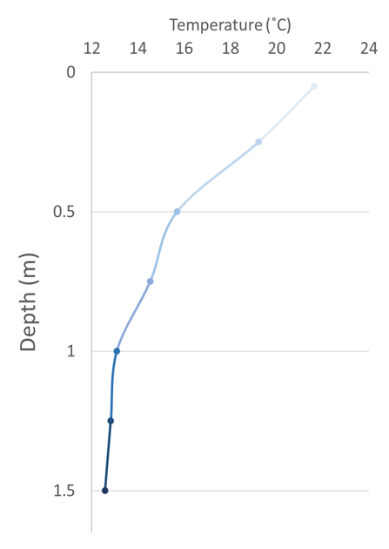
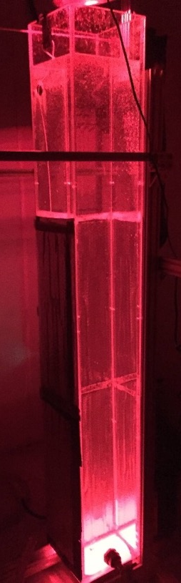
Methods: Creating a Thermocline
ADAC Program Year 6 Annual Meeting 14 May 2020
OBJECTIVE 3: Determine the influence of water column stratification on contact between copepods and oil (with and w/o oil; Phase III)
Next Step: Experiments with copepods and (i) oil/dispersants (ii) oil-only

Slide 17
Year 6 Milestones: Current Status
ADAC Program Year 6 Annual Meeting 14 May 2020
MILESTONES METRICS
Phase I: Oil avoidance of copepods 80% in progress
Task 1: Copepod tower construction & optimization 100% completed
→ presented to Advisory group in Oct.; decision to go forward ✓ 100% completed
Task 2: Three experiments with and without oil 100% completed
Task 3: Copepod data evaluation 100% completed
Task 4: Chemical analysis & data evaluation 100% completed
Task 5: Manuscript 1: Oil avoidance 0% not started (milestone 6/30/2020)
Phase II: Dispersants and copepod contact 25% in progress
Task 6a: Experiments with dispersed oil (chemistry) 100% completed
Task 6b: Experiments with dispersed oil (copepod) 0% not started (planned March/May2020)
Task 7: Copepod data evaluation 0% not started (planned for Year 7)
Task 8: Chemical analysis & data evaluation 0% not started (planned for Year 7)
Phase III: Influence of Stratification 25% in progress
Task 9a: Set Exp. with stratification 100% in progress (milestone for End of March 2020)
Task 9b: Exp. with stratification (chemistry) + copepod) 0% not started (planned May/June 2020)
COVID-19 changes:
June/July 2020
Aug/Sept 2020

Slide 18
Progress on Outcomes/Output
ADAC Program Year 6 Annual Meeting 14 May 2020
Update on feedback from Project Champion
and Other Engagement
On track based on Project Champion and Advisors Group
Project Champion reviewed Task 1; data received Go-Ahead March 2020
Finish Research and Knowledge Product in Year 7
Update on Transition and TRL
Transition is via Knowledge Product and TRL associated with Fundamental Research

Slide 19
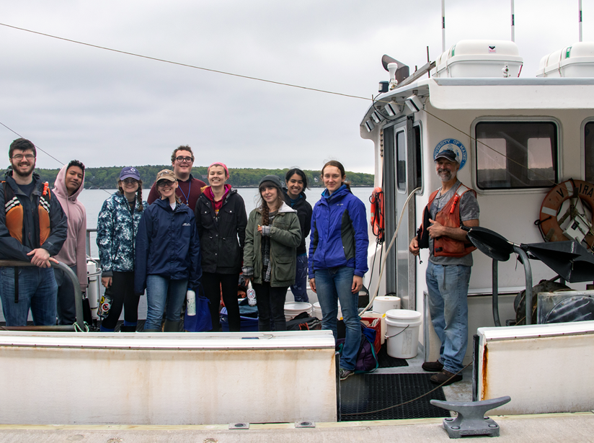
Student contributions
ADAC Program Year 6 Annual Meeting 14 May 2020
Our goal is to bring 2 students onboard in June of 2020.
1st student will be responsible for:
Collection and maintaining of copepods
Analyzing video images of copepod distribution in the tanks
2nd Student will be responsible for
dispersant tests
collecting and analyzing hydrocarbon
Plan modified due to COVID-19:
remote program for students
(image and data analysis)
experiments will be
performed by us
Bigelow Summer Students

Slide 20
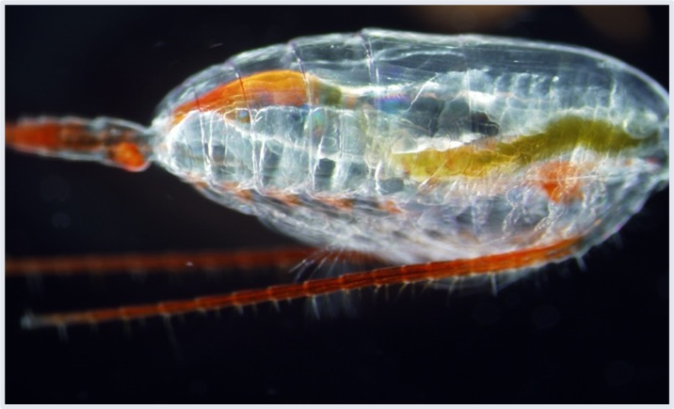
Arctic Copepods: Questions?
ADAC Program Year 6 Annual Meeting 14 May 2020
Feedback…
What are we missing?
What can we improve?
Who should we connect with to improve odds of research success?

